Slide 1


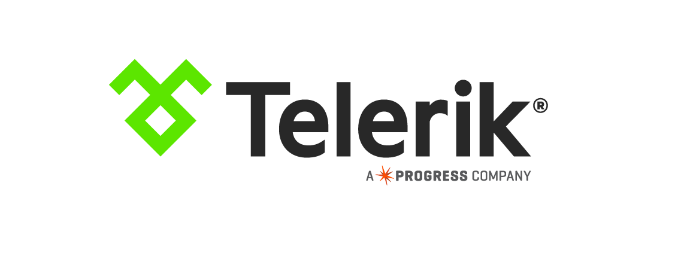
6 Minute Mobile Apps with NativeScript
A Race Against Time

Slide 2
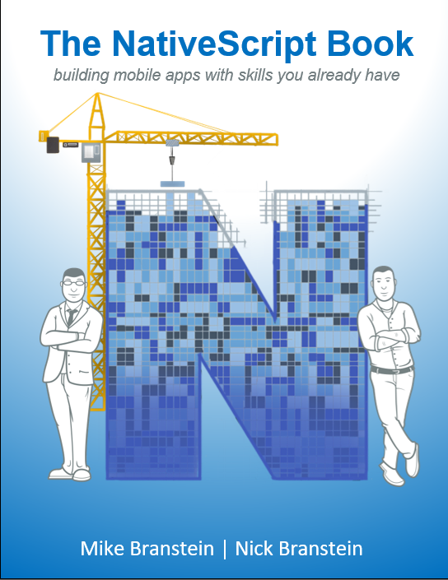
Mike Branstein
@mikebranstein
https://brosteins.com
@brosteins
nativescript.org/book
http://kizan.com

Slide 3
Agenda
Today’s Rules
Intro to NativeScript
Why it’s different
Audience participation
6-minute app challenge
Notes:
Rules:
I need your help – volunteer to help me keep track of how many apps we create
I’m going to move fast – really fast, but I think you can keep up

Slide 4
NativeScript is…
an open source framework for building truly native mobile apps with JavaScript. Use web skills, like TypeScript, Angular, and CSS, and get native UI and performance on iOS and Android.
Notes:
I want to call out a few things about what NativeScript is an what it is not.
You can build mobile apps with:
JavaScript, markup, and CSS
Similar to hybrid apps in that you can use Angular 2, CSS, skills to write apps
You get native performance, because you’re running native code
Not in a web view
Native discussion
Before we go any further, OK, what I want you to come away with today is that there are options. A lot of options for mobile development. Native, Phone Gap/Cordova, Xamarin, and NativeScript.
This talk isn’t about saying that NativeScript is the best choice for every app, because you can write great apps in all of these technologies.
But this is a compelling technology.

Slide 5
Created and supported by Telerik
Notes:
I mention this because, in today’s world, where you have a multitude of options, constantly evolving, it’s important to pick an innovative and stable options.

Slide 6
Innovative and Stable
- Strong backing by Progress and Telerik
- Open source, with Apache 2.0
- Paid support offering
- Advanced tooling = greater productivity
- Easy to learn, with various options: Core, Angular, Vue
- Large collection of libraries: NodeJS, Plugins site, Use CocoaPods
- Near-native performance…because it’s Native UI
- Telerik’s NativeScript Premium UI Controls for free
Notes:
I mention this because, in today’s world, where you have a multitude of options, constantly evolving, it’s important to pick an innovative and stable options.
Stable
Strong backing by Progress and Telerik – you’ll recognize Telerik from the UI component space with Kendo UI or their UI Controls for Angular.
Open source, and with Apache 2.0 licensing
Paid support offering
Advanced tooling: VS Code integration, Chrome Debugger Tools integration, NativeScript Sidekick app, CLI, NativeScript Playground, Kinvey
It’s easy to learn – I learned the basics of {N} in 2 hours, then wrote my first app in another 2 hours
B/c it’s JavaScript, there’s already an ecosystem
Near-native performance
Premium UI components make it easy to develop great apps quickly

Slide 7
The {N} difference…
Notes:
How?
Let’s talk about 3 reasons why NativeScript is different.

Slide 8
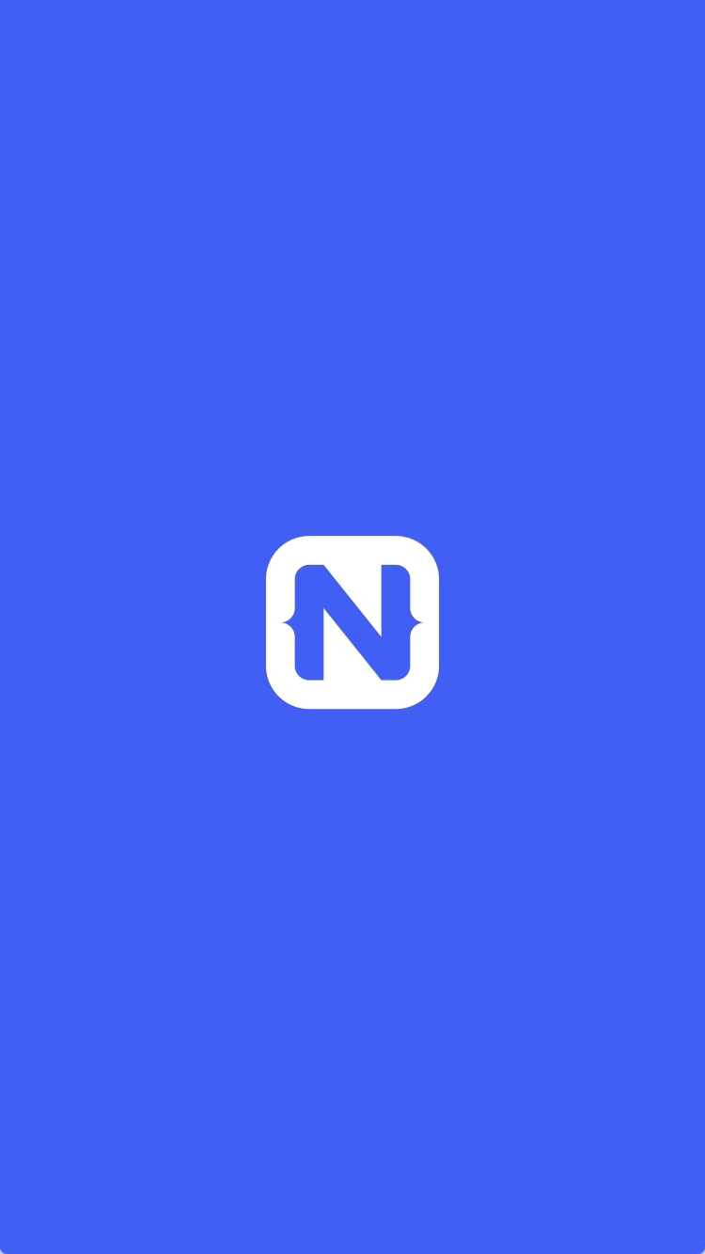
1
Rich, animated, “no compromise” native UI
(with shared UI code)
Search for
“Examples NativeScript”
in the iOS App Store or Google Play to try this out for yourself.
Notes:
One.
You have access to native UI components on iOS and Android, with native performance, with shared UI code. You write markup, this is directly transposed to native UI elements and rendered.
Head to the Android and iOS stores to get a copy of this app and see for yourself – search for “Examples NativeScript”

Slide 9
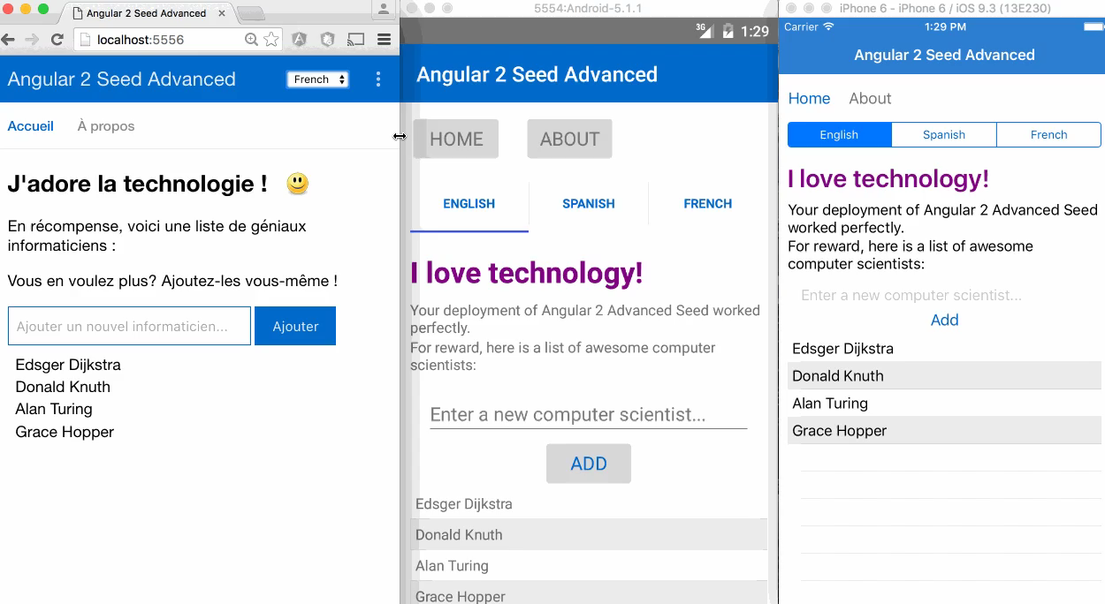
2
Maximum code and skill reusability
Video credit: Nathan Walker, {N} community member
Notes:
Two
Do you currently use npm, CocoaPods, Android Arsenal? You can use that with {N}. Here’s the same app, running in-browser, on Android, and on iOS. Same code, 3 platforms.

Slide 10
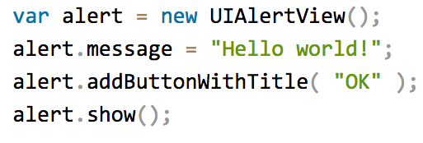
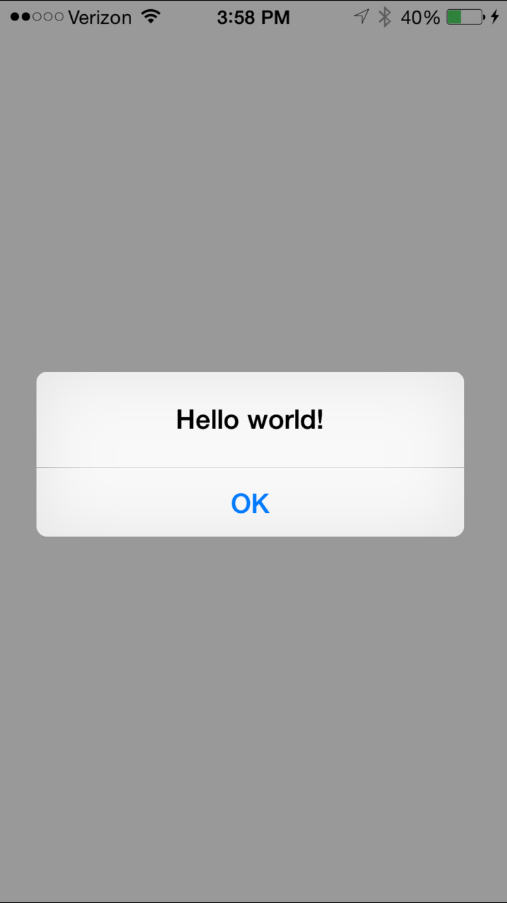
3
100% access to Android and iOS APIs
Notes:
Three dot One
This is where it gets really cool:
this is the iOS API
but it’s not written with Objective-C – it’s really JavaScript using the iOS API

Slide 11
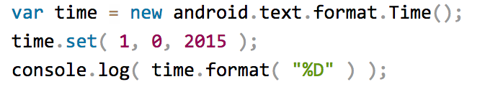


Runs on V8 JavaScript VM
Runs on JavaScriptCore VM
More details at http://bit.ly/how-nativescript-works
Notes:
Three dot Two
Here’s how it works:
You access the native apis directly from JavaScript
Your app runs in a JavaScript VM
V8 on Android, JavaScriptCode on iOS
When the app runs, the VM marshals the API calls directly down to the native API, running in real-time

Slide 12
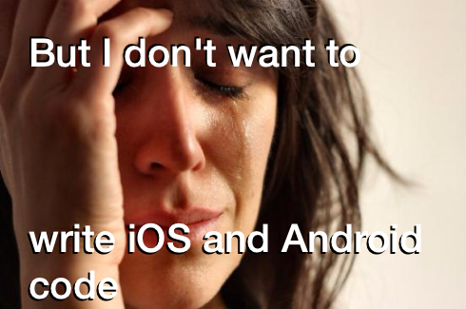
Notes:
That’s ok.

Slide 13
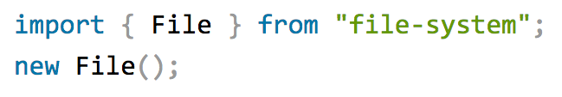



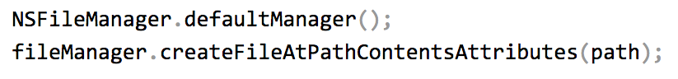
Example: NativeScript file module
Notes:
There is a set of core modules that abstract these things away for you, so you have a unified experience across the platforms,
BUT if you really need to access Objective C and Java directly, that capability is always there.

Slide 14

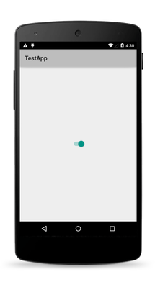
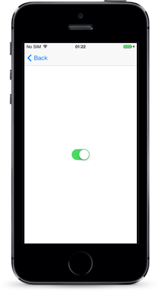
The same approach works for the UI
Notes:
The XML markup you use for a UI is actually instantiates the JavaScript objects, which get mapped back to native API objects.

Slide 15
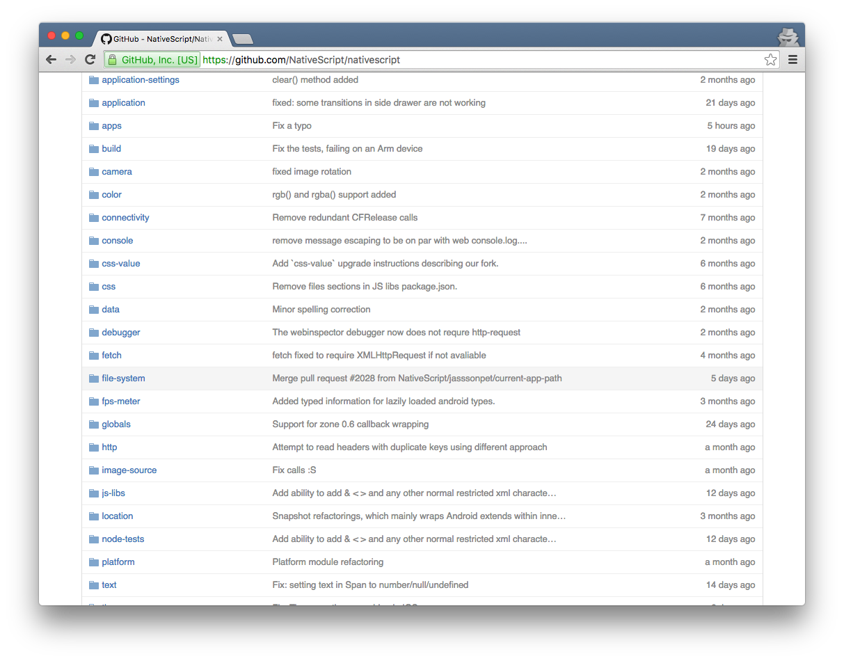
NativeScript Modules—There are a lot

Slide 16
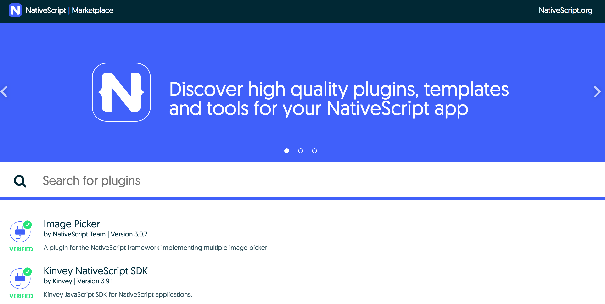
NativeScript Plugins
Notes:
When the core modules of NativeScript aren’t good enough, there are 100’s of plugins built by Telerik and the community available. They’re free, and the NativeScript team works to ensure they’re reliable and high-quality.

Slide 17
I need your help!
@MikeBranstein
#MakeMeAnApp

Slide 18
Let’s get ready to…

Slide 19

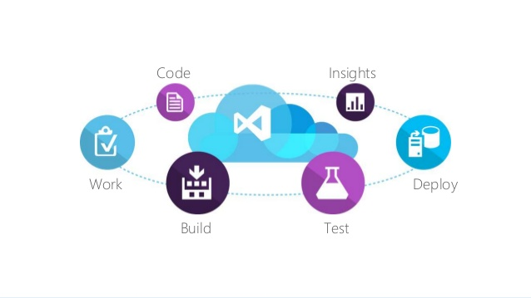




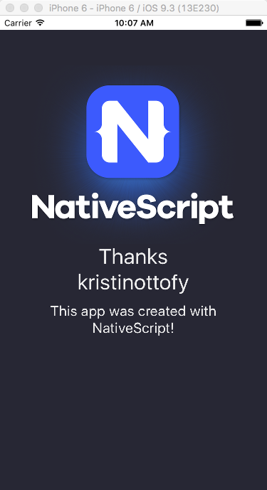
triggers
listener
Azure Logic App
if (tweet-found)
then (trigger-build)
Visual Studio Team Services (VSTS) Build
@MikeBranstein
#MakeMeAnApp
reply tweet
git repo
queues build
tns run ios
{N} App Template
screenshot to Azure REST API endpoint
VSTS Mac Build Agent
VSTS Mac Build Agent

Slide 20
Mike Branstein
@mikebranstein
https://brosteins.com
@brosteins
nativescript.org/book
http://kizan.com

Slide 21


Other Resources
Online Video and eLearning
https://NativeScripting.com
https://play.nativescript.org

Slide 22
Repository
https://github.com/mikebranstein/six-minute-mobile-apps

